Slide 1
The American Revolution
The Early Years

Slide 2
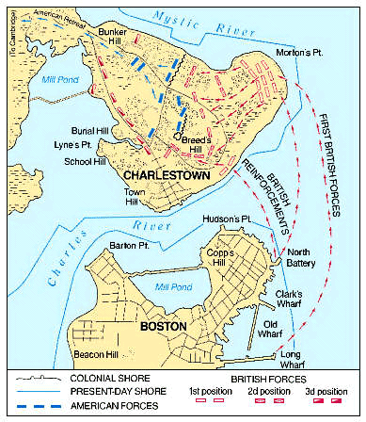
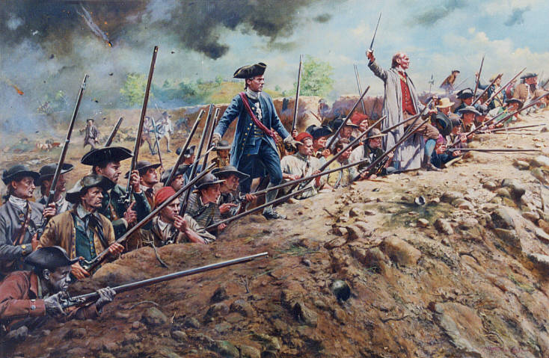
Bunker Hill- June 1775
Just outside Boston
British win; Americans inflict heavy casualties on them
OVERALL TAKEAWAY:
Confidence boost for colonists!!

Slide 3
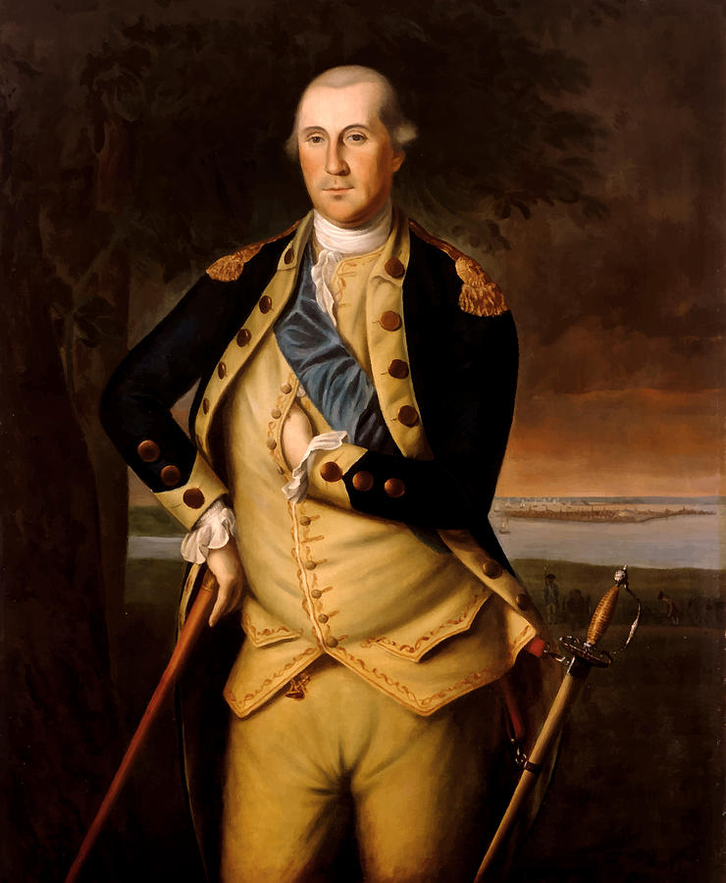
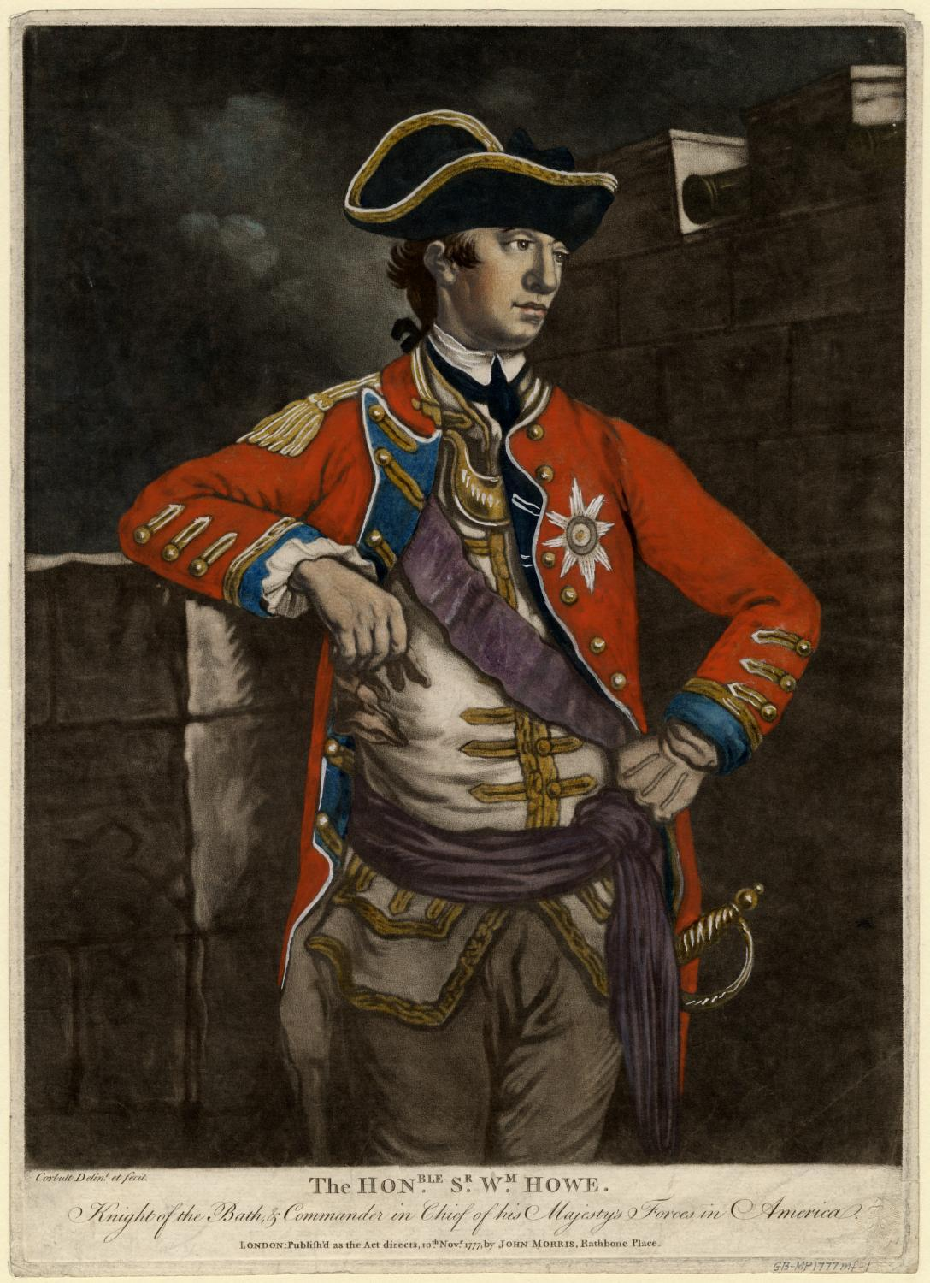
Washington Selected
Two days later (June 19th), Washington is appointed Commander of the army- TOOK NO PAY
Gets to Boston and positioned cannons to force British retreat into Canada
General Washington
General Howe

Slide 4
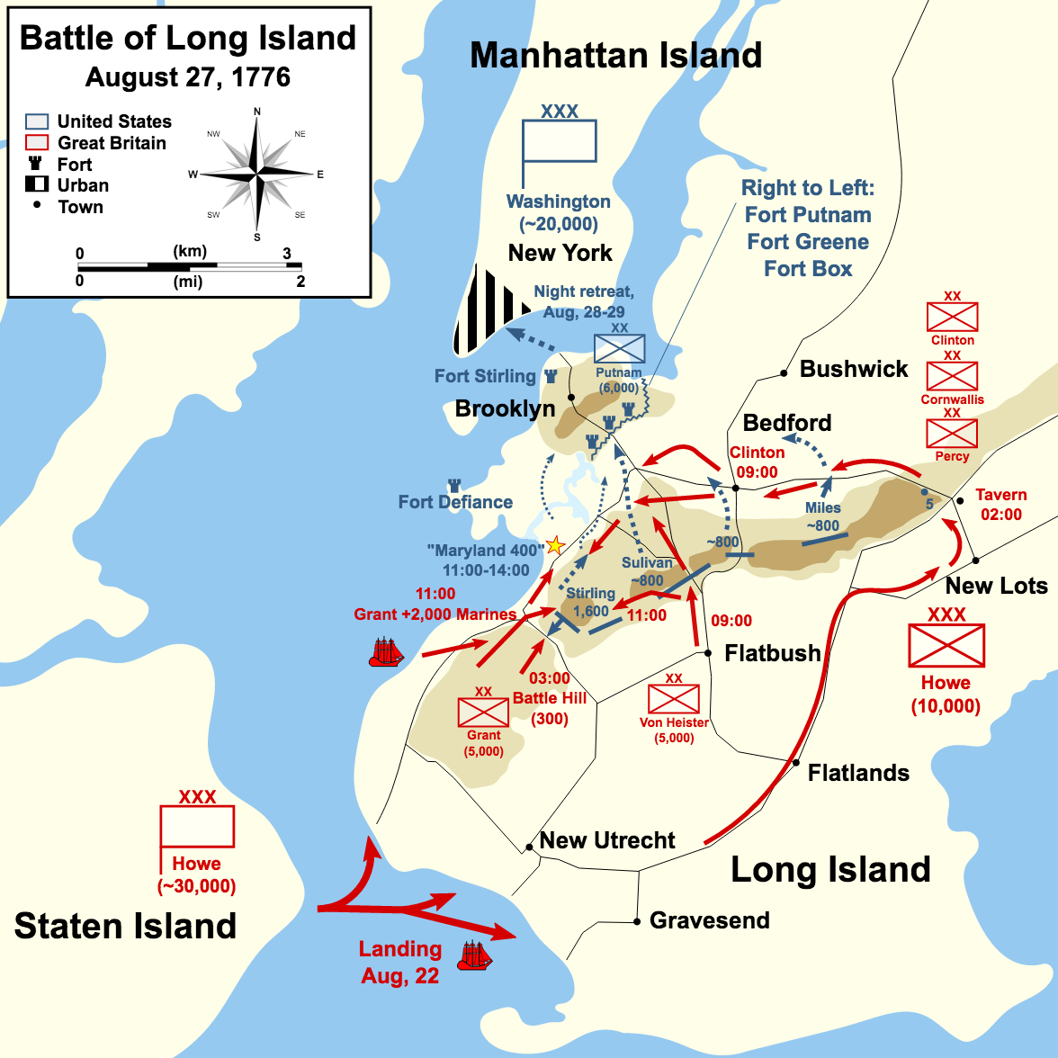
New York campaign- July and August. 1776
Howe gets to Long Island with with total of 400 ships and over 30,000 soldiers
Washington realized troops were surrounded, evacuated island back to Manhattan
9,000 troops were moved in the fog, Washington was last one off the boat

Slide 5
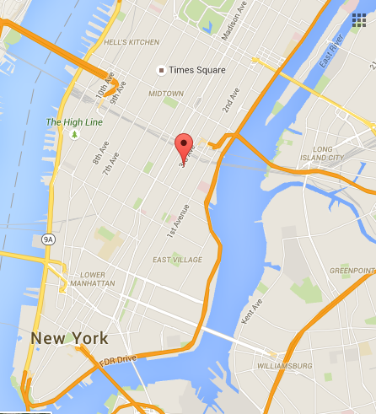
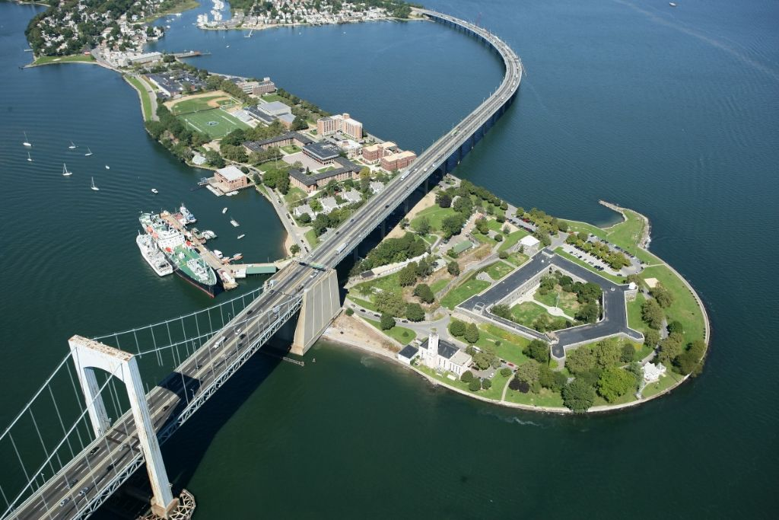
The situation gets bad fast
Kip’s Bay- 3rd Ave & 24th Street
Throng’s Neck

Slide 6
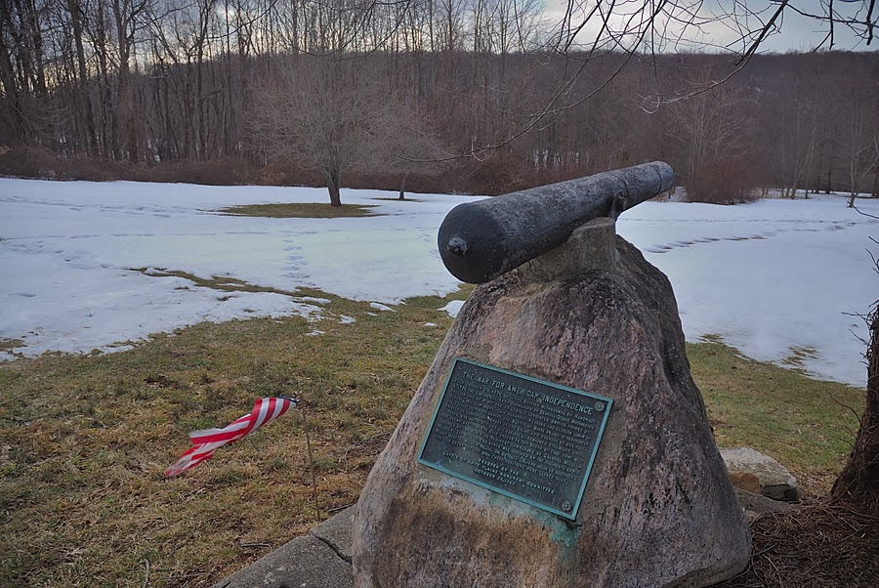
White plains and Manhattan
American troops overwhelmed by British at White Plains and forced to retreat back to Manhattan

Slide 8
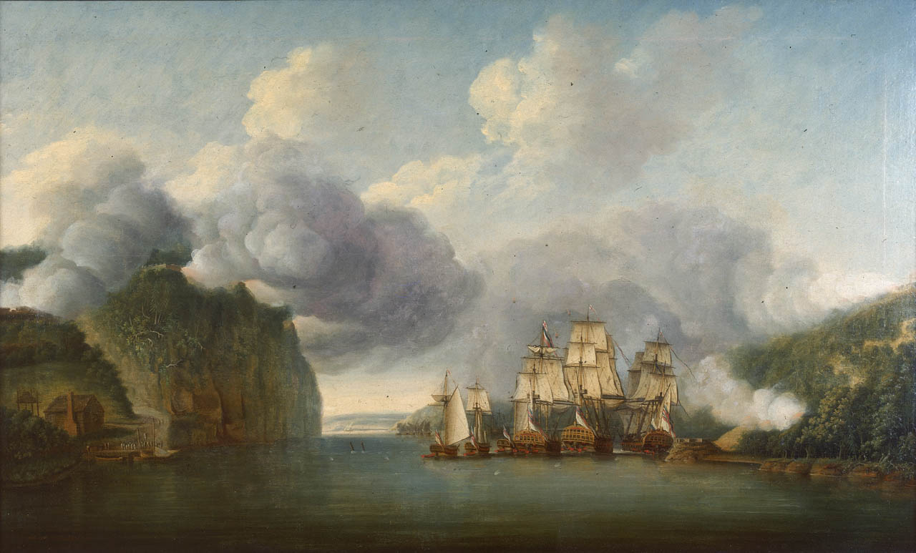
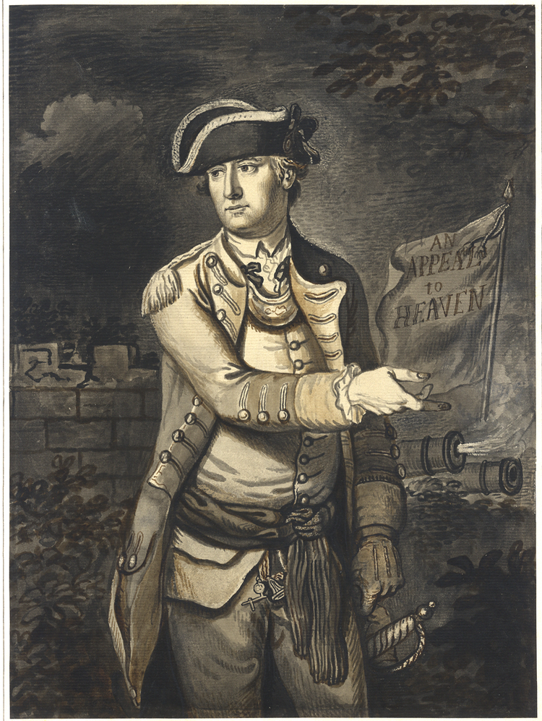

Slide 9
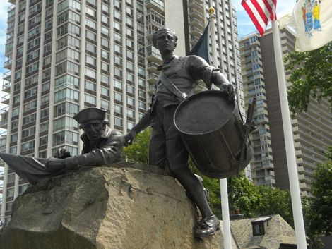
Fort Lee Surrendered

Slide 10
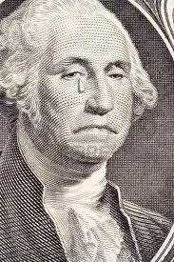
What is next?
Between July and October, America loses New York
Washington is forced to retreat into New Jersey
“I am wearied almost to death with the retrograde motions of things.”

